Slide 1
Computer Crimes - Sexting

Slide 2
Age of Adulthood
A child is defined as any person under a certain age
In Korea – Age of Majority is 19.
Minors, as opposed to adults, cannot consent to many legal activities:
Signing contracts
Taking Loans
Voting

Slide 3
But wait – Criminal Liability?
Criminal Law also has a distinction between children (i.e. “Juvenile”) and adults.
Children should not be punished as severely as adults.
Generally their cases go to “Juvenile Courts”
For example:
No Jury Trial
Focus on Rehabilitation
Closed Hearings and Records

Slide 4
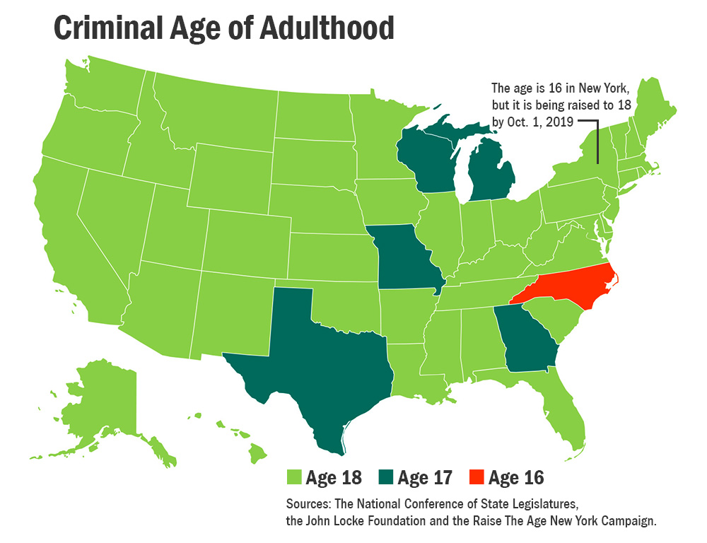

Slide 5
Is it really that simple? (Of course not)
However, the age of adulthood for criminal prosecutions is not absolute.
States MAY move a juvenile from juvenile court to adult court and prosecute the juvenile as if he/she was an adult based on certain types of crimes committed.

Slide 6
Transfer
The process is called “transfer”, although there are different forms:
Judicial waiver: The case is filed originally in juvenile court but may be transferred with a judge’s approval, following a formal hearing
Prosecutorial discretion: Cases that may be brought in either juvenile or criminal court. The decision is entrusted entirely to the prosecutor.
Statutory exclusion/Automatic Transfer: grant criminal courts exclusive jurisdiction over certain classes of cases involving juvenile-age offenders:
The Age of the offender is some minimum (e.g. 16)
The type of crime is serious (e.g. rape or murder)

Slide 7
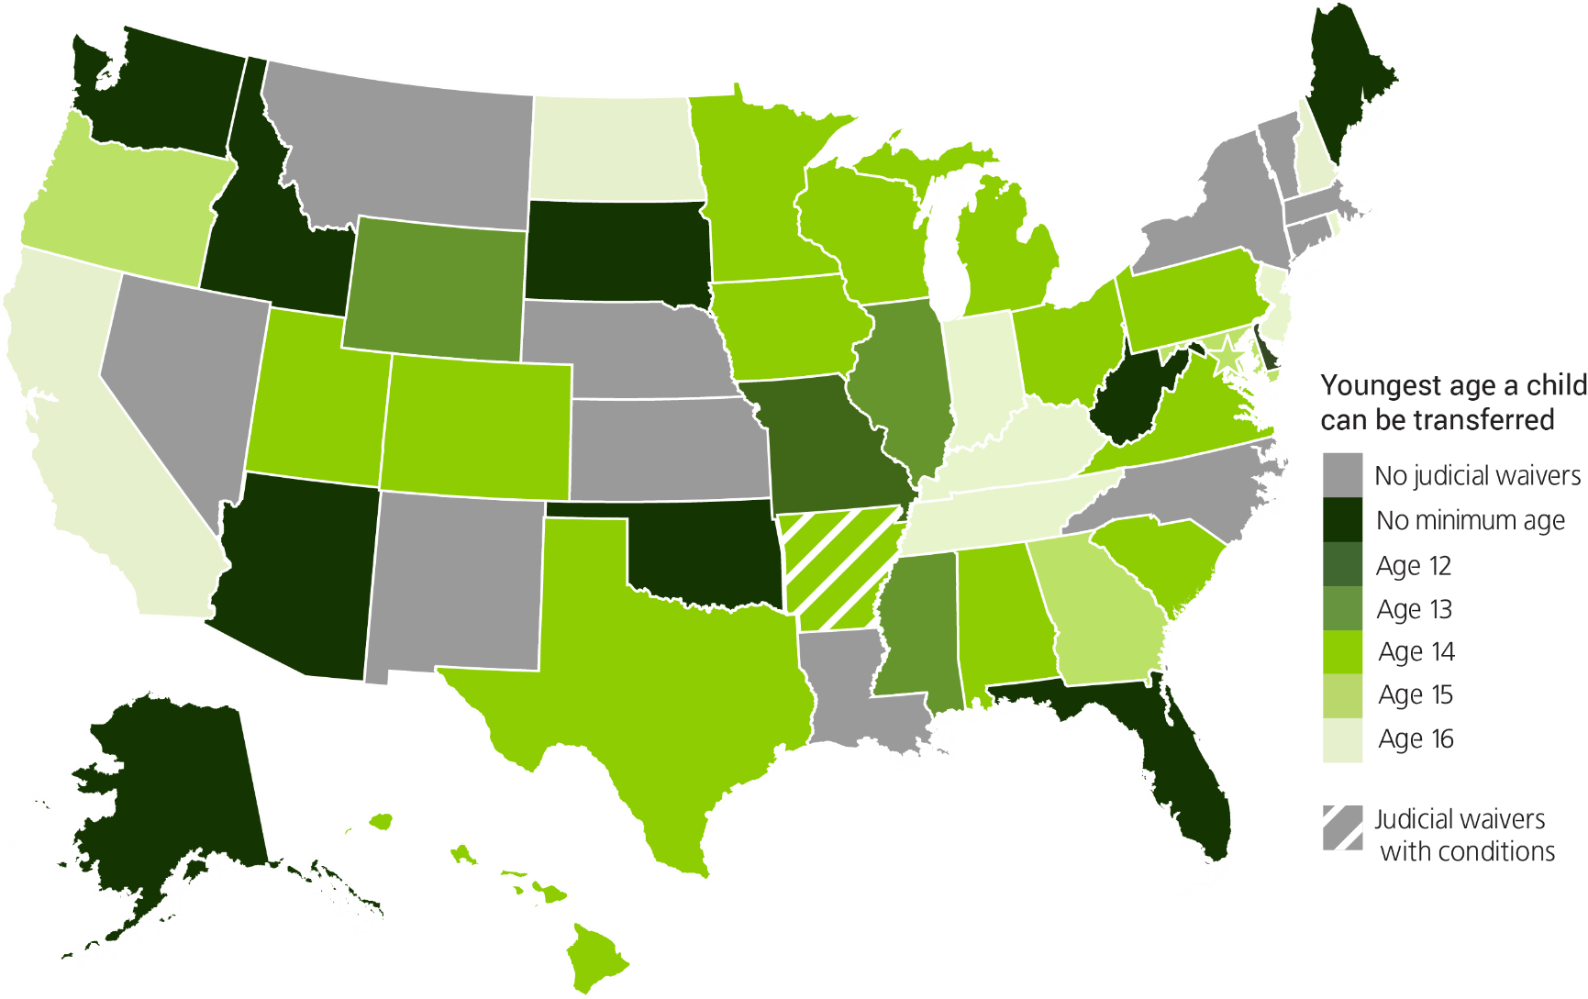

Slide 8
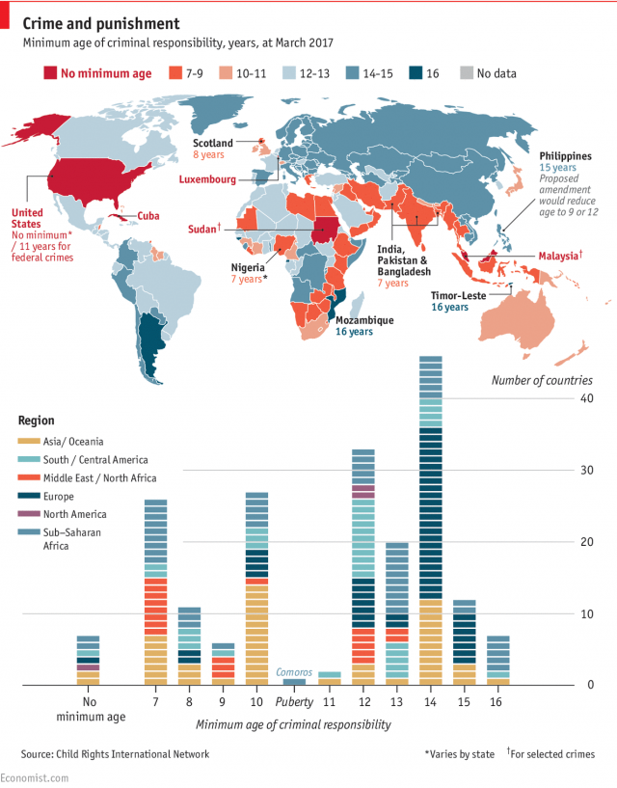

Slide 9
Age of Consent
Although apparently similar, Age of Consent only relates to the minimum age a person can consent to sexual activities.
Age of Consent in Korea?
This a legal fiction – the law assumes that a person under the Age of Consent is incapable of making the decision to engage in sex.

Slide 10
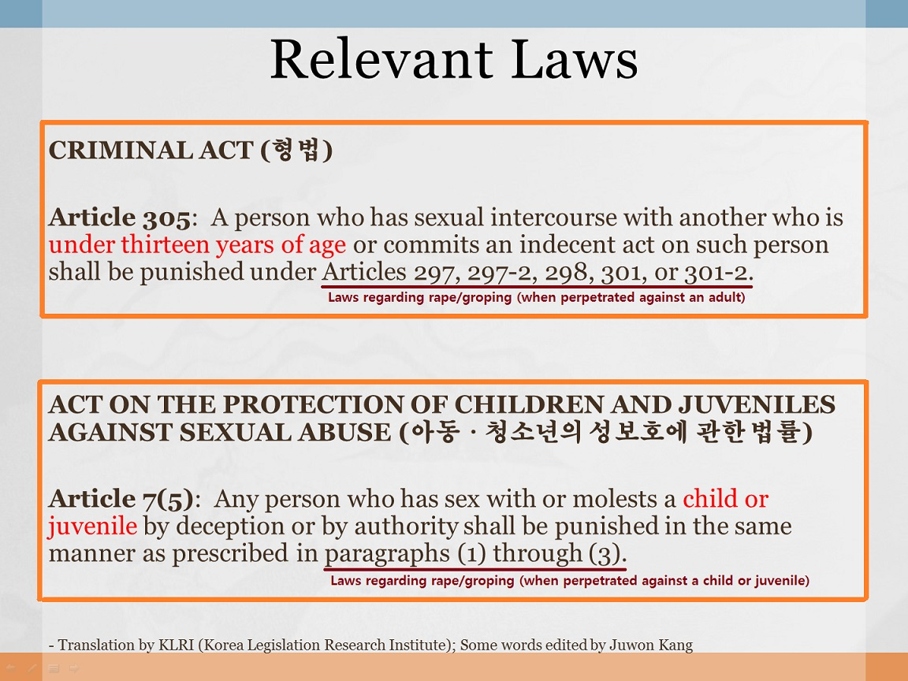

Slide 11
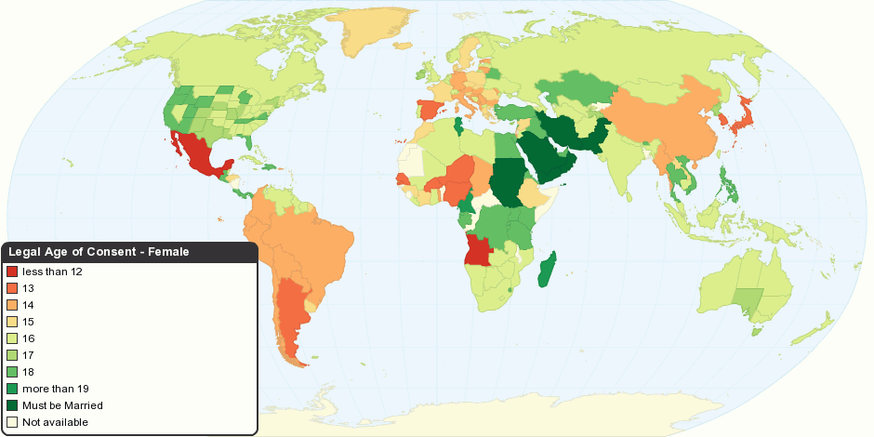

Slide 12
Statutory Rape
Statutory Rape –
Statutory rape laws are based on the premise that an individual is legally incapable of consenting to sexual intercourse until that person reaches a certain age.
Statutory Rape law is a “Strict Liability” law
The law mandates that even if a person willingly engages in sexual intercourse, the sex is not consensual. Intent/Knowledge is not required to break the law.

Slide 13

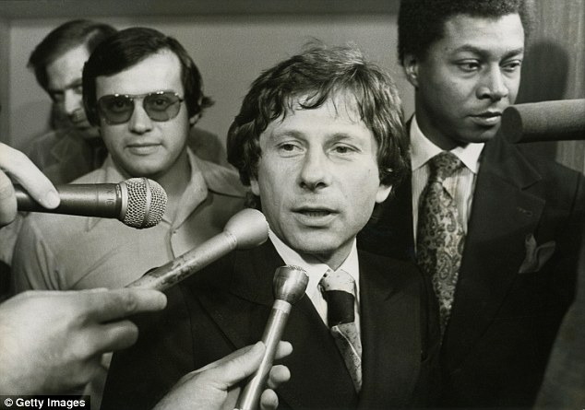
Statutory Rape
What happens if both consenting persons are minors?
“Romeo and Juliet” Exception may apply

Slide 14
Child Pornography
Remember:
Age of Adult Criminal Liability
Age of Consent

Slide 16
Summary of the CP Law
A different and more stringent standard is applied to images involving children than to images involving adults.
Adult: Only “Obscene” material is illegal
Children: ANY sexually explicit conduct that is lascivious or suggestive is illegal

Slide 17
1978 | Sexual Exploitation of Children Act | First federal law specifically dealing with child pornography. Prohibited the manufacture and commercial distribution of obscene material involving minors under 16
1982 | New York v. Ferber | Child pornography not protected by the First Amendment.
1984 | Child Protection Act | Age of minor covered by child pornography legislation was raised to 18, and distinction between child pornography and obscenity codified.
1986 | United States v. Dost | Expanded the definition of child pornography to include sexually suggestive depictions of a lascivious nature.
1988 | Child Protection and Obscenity Enforcement Act | Illegal to use a computer to depict or advertise child pornography
1990 | Osborne v. Ohio | Private possession of child pornography illegal.
1996 | Child Pornography Protection Act | Definition expanded to include virtual images of children and images that appear to be of a minor.
1998 | Child Protector and Sexual Predator Punishment Act | Internet Service Providers (ISPs) required to report known incidents of child pornography to authorities, but not required to actively monitor customers or sites.
2002 | Ashcroft v. Free Speech Coalition | “Virtual” images banned.

Slide 18
Summary of the Law
Possession of (not just production and trading of) child pornography is a criminal offense. In the case of the Internet, images do not have to be saved for an offense to have occurred—they simply need to have been accessed.
No “Romeo/Julieet” Exception.

Slide 19
Summary of the Law
Internet Service Providers (ISPs) can also be prosecuted for knowingly allowing trafficking of CP through their servers.

Slide 20
Sexting – What is it?
“Sexting" is the practice of sending nude or semi-nude pictures by cell phone or other electronic media: i.e. a sexual text ('sext') message.

Slide 21
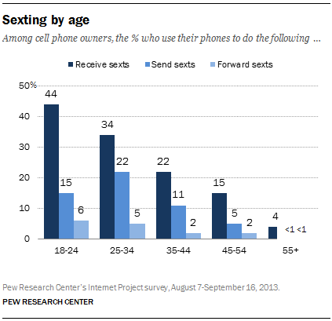

Slide 22
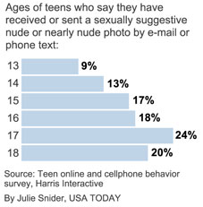

Slide 23
Sexting & Child Pornography Law
What happens when a minor sends an explicit photo?
What if the recipient is a minor?

Slide 24
Case Example
Mr. Copening and his girlfriend, Brianna Denson, were like other teenagers in that they have more than a passing interest in sex.
Indeed, when they were 16, they exchanged racy sexy photos via text message. Denson sent pictures to Copening, and Copening sent pictures to Denson.
It appears that no one else saw the pictures until local authorities searched Copening’s phone and discovered them.

Slide 25
Sexting – Case Example
[Prosecutors] charged 17-year-old Copening with sexual exploitation of a minor—his girlfriend, who is the same age—because the couple sent each other nude photos of themselves during their relationship.
Both were 16 when the activity took place.
NC age of Consent: 16. But in NC, 16 is the age of adulthood for criminal charges.

Slide 26
Sexting – Case Example
Copening [faced] two counts of second-degree sexual exploitation and three counts of third-degree exploitation. The third-degree charges—which constitute a majority of the total charges—actually stem from the pictures Copening had of himself.

Slide 27
State responses
Approximately 20 states have adjusted or are attempting to change their laws to take into consideration sexting:
For example, Nebraska:
It is a felony to either possess or distribute sexually explicit images of a child. For those charged with possession, individuals that are eighteen and younger shall have an affirmative defense if they received a sexually explicit image of a minor, that is at least at fifteen years old, that was voluntary and knowingly created and provided by the minor, the image only depicts the one child, the defendant did not distribute the image to another person, and the defendant did not pressure the child to transmit or generate the image.

Slide 28
State Responses
New York:
The two persons involved in sending and receiving the message must both be under twenty and must be within five years of age from each other. They will have to participate in an education reform program that involves a maximum of eight hours of instruction that provides information regarding the legal consequences and non-legal consequences of sexting, and the problems associated with technology and bullying.

